Slide 2
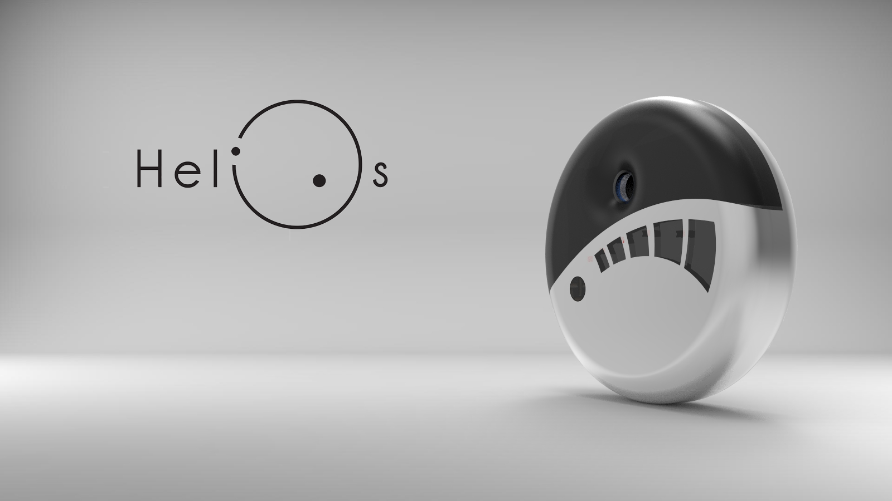

Wearable UV meter
TEAM 2

Slide 3
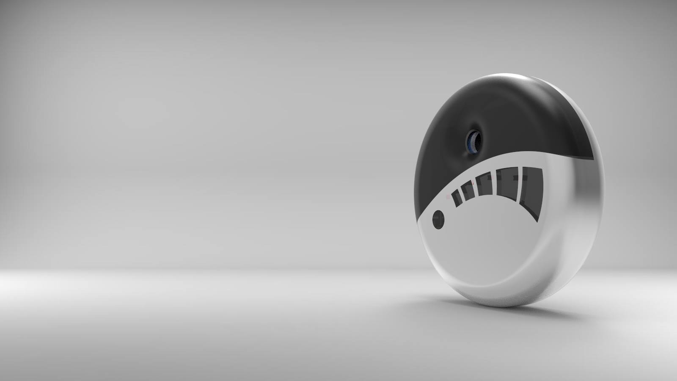

The Team
Problem
Idea
Proposed Solution:
Requirements
Tasks/People/Dates
Design Structure
Control System
Functionalities
Tests & Results
Conclusions
CONTENT

Slide 4

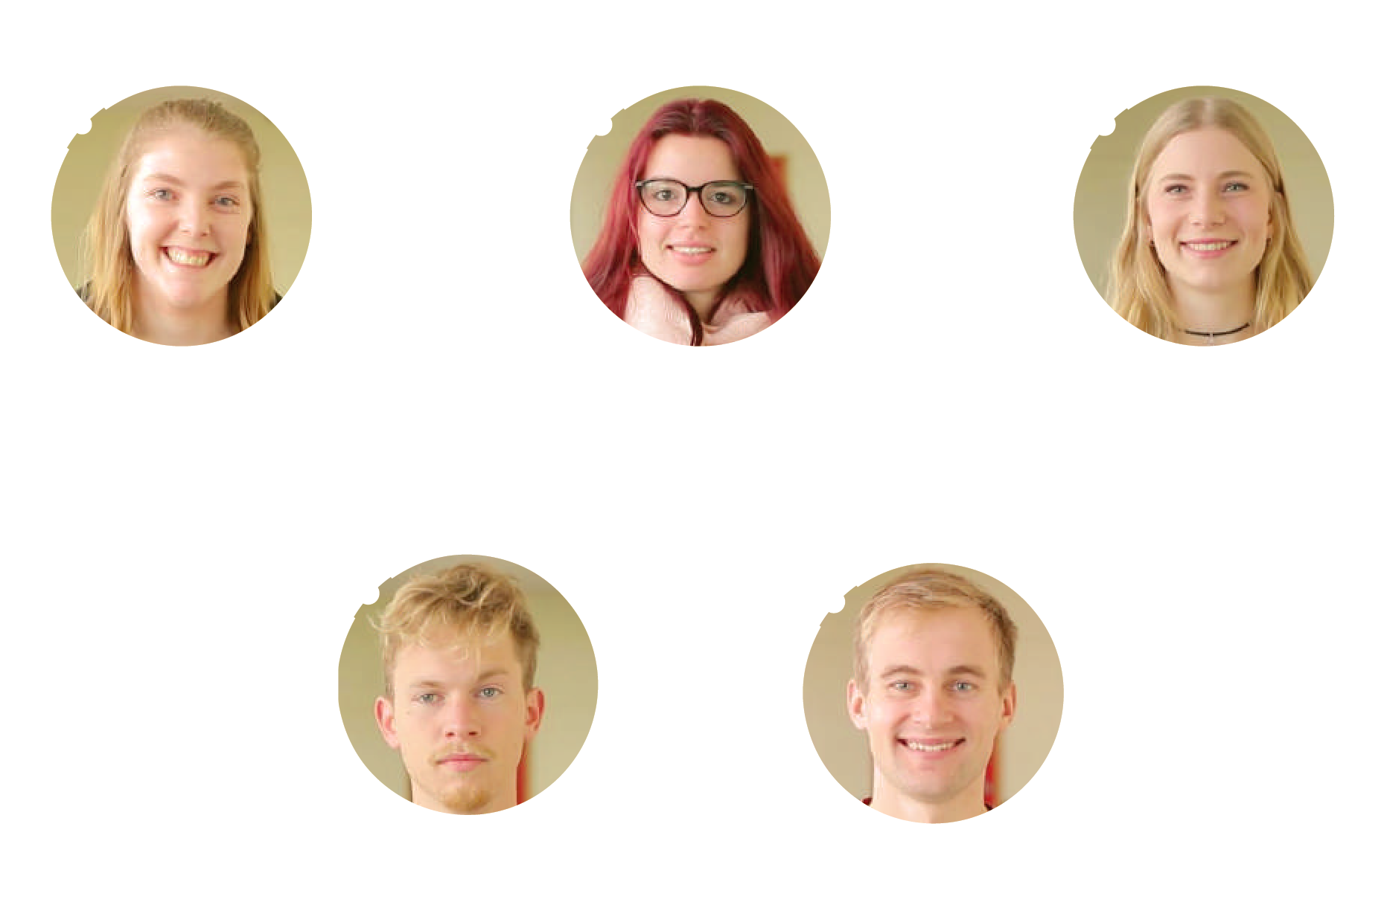
Elin Lönnqvist
Industrial Management
Finland
Marion Cullié
Packaging Engineering
France
Simone Smits
Biology & Medical
labresearch
The Netherlands
Miquel Borrás
Industrial, Product & Graphic design
Spain
Mikk Tootsi
Electrical Engineering
Estonia
THE TEAM

Slide 5
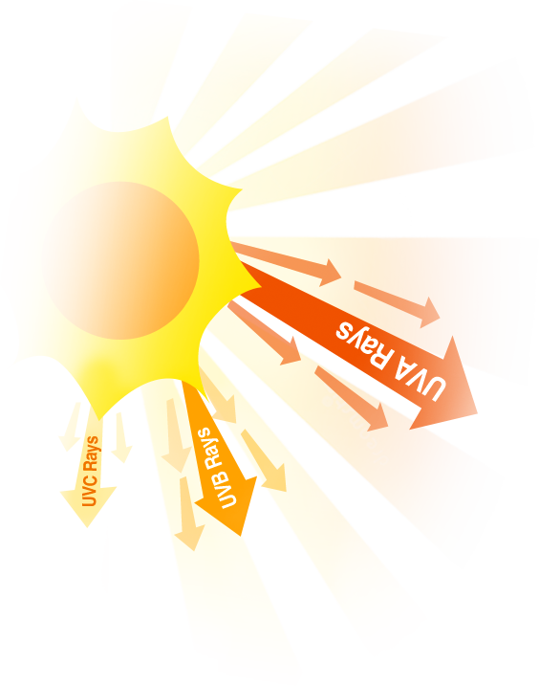


Healthy bones
Hormone
UVA Rays
Warmth
Well-being
UVB Rays
UVC Rays
Mutations:
Skin cancers
Over-exposure:
ageing skin, wrinkling &
eye damage
Mutagenic damage to DNA
PROBLEM

Slide 6
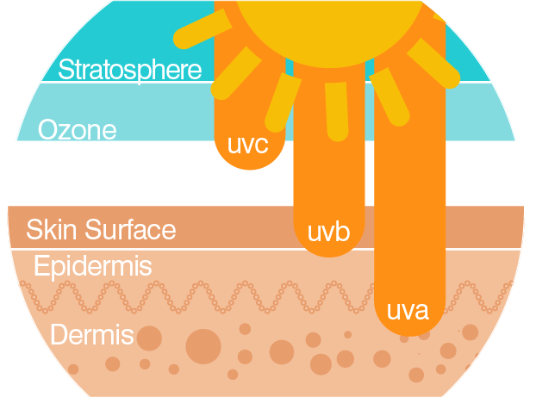

Nonmelanoma skin cancers (NMSC):
basal cell carcinoma (BCC) and
squamous cell carcinoma (SCC)
320-400 nm 280-320 nm 100-280 nm
1,000,000
PROBLEM

Slide 7

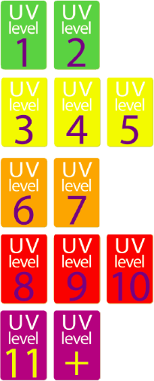
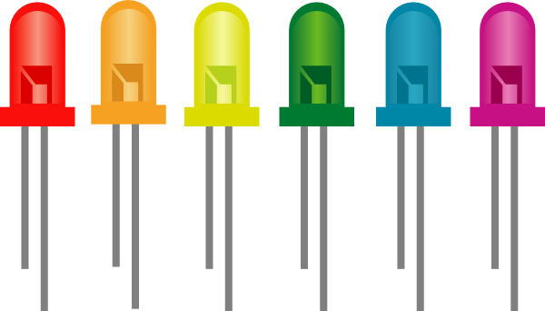
An indication of the UV index
Marketing, Sustainability & Ethical analyses
IDEA

Slide 8

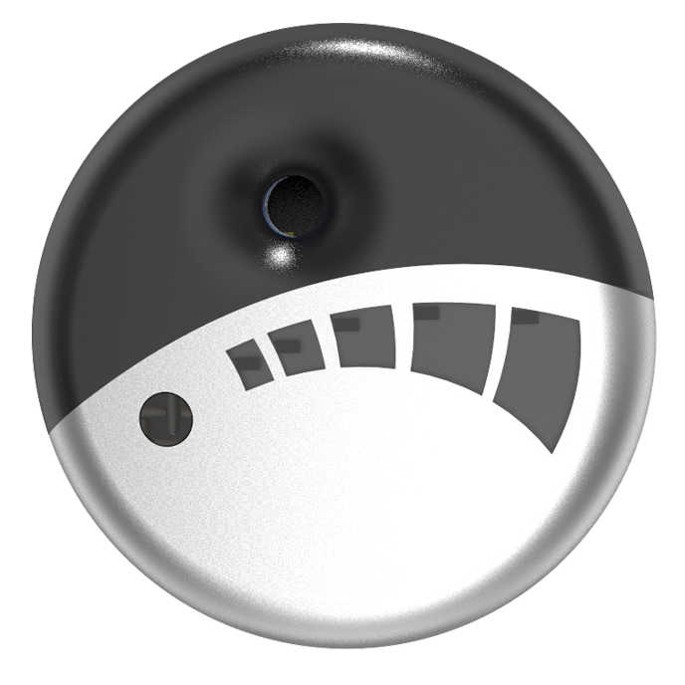
PROPOSED SOLUTION

Slide 9

Not exceed the budget of 100 €
Uses low cost hardware solutions
Uses open source software and technologies
Comply with the EU Directives and the use of
the International System of Units
REQUIREMENTS

Slide 10




Wearable
Skin care
Waterproof
Connectable
REQUIREMENTS

Slide 11
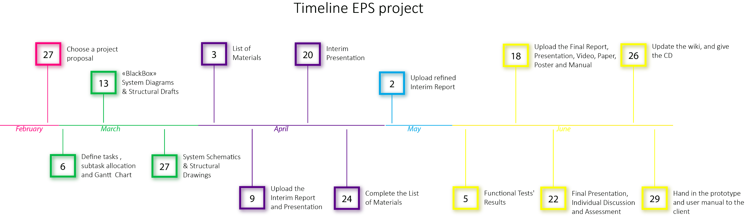
Tasks/People/Dates

Slide 12
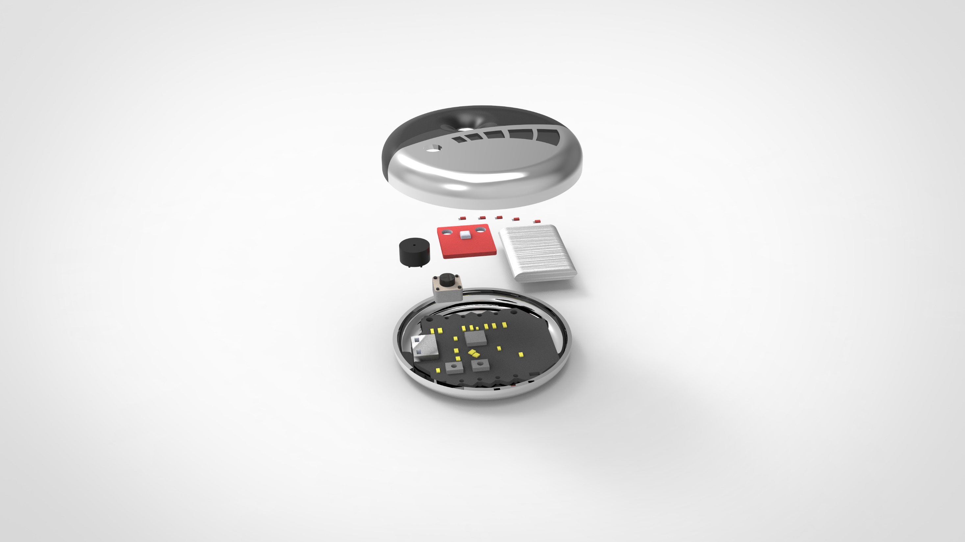

Hole for the UV sensor
UV sensor ML8511
LED lights
Buzzer Kobitone
Lithium-ion Polymer battery 3.7 V 550 mAh
On/Off
Button
Bluno Beetle DFR0339
DESIGN

Slide 13

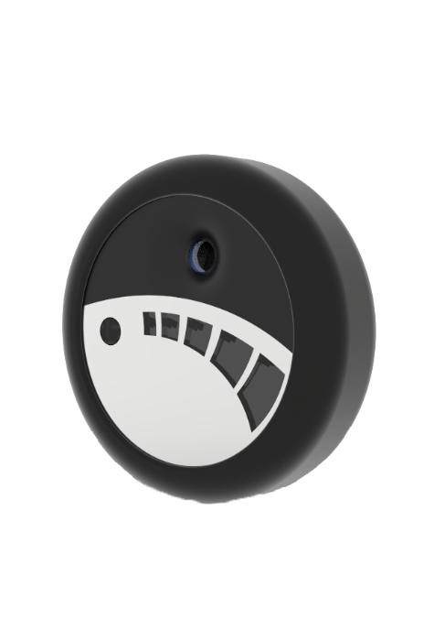
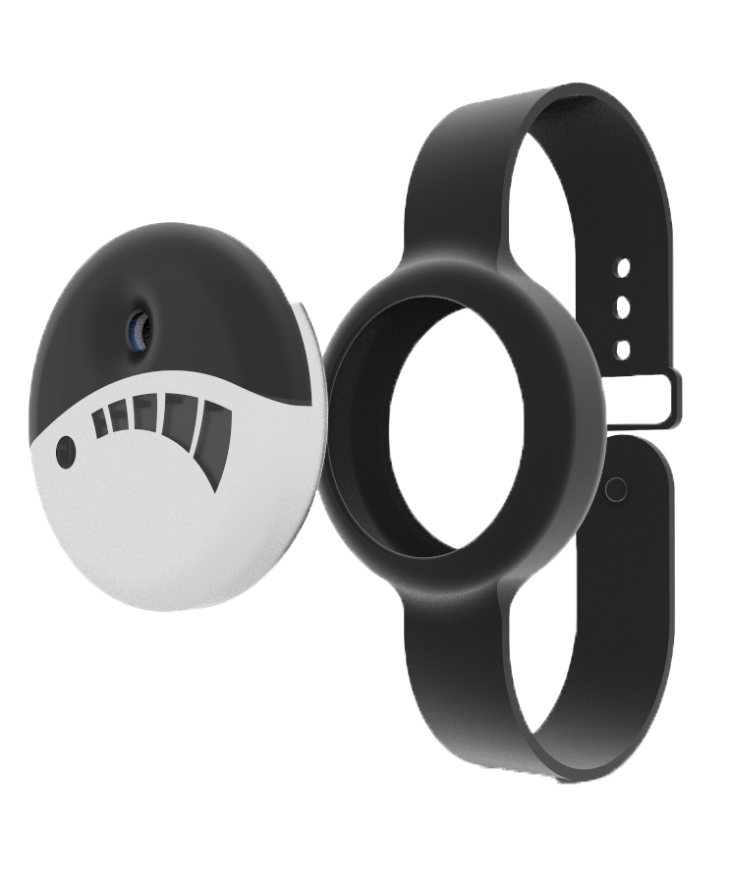
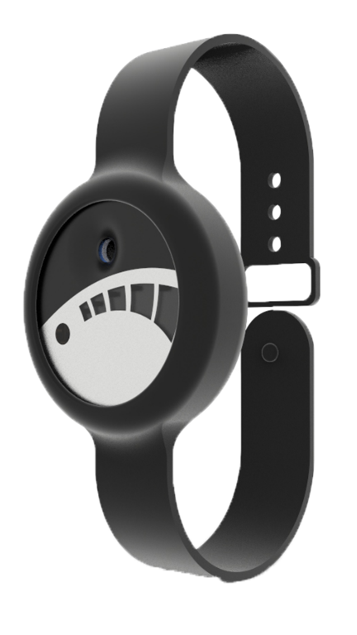
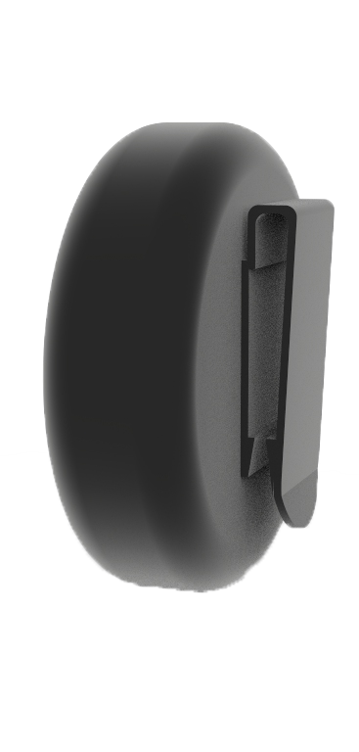
DESIGN

Slide 14

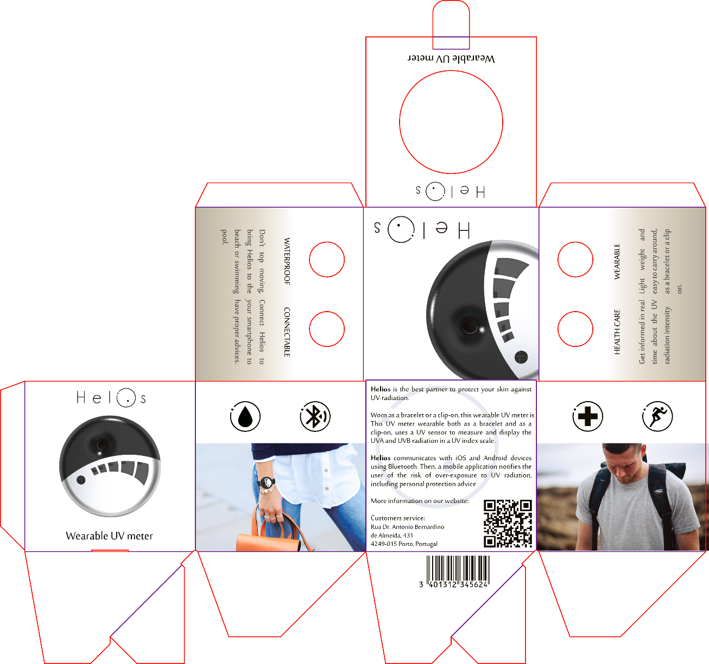
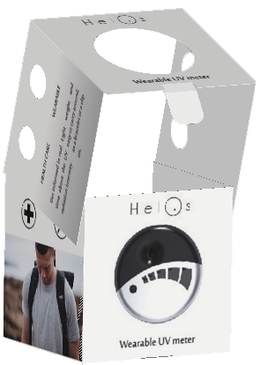
PACKAGING

Slide 15
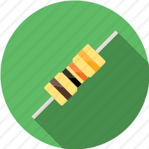
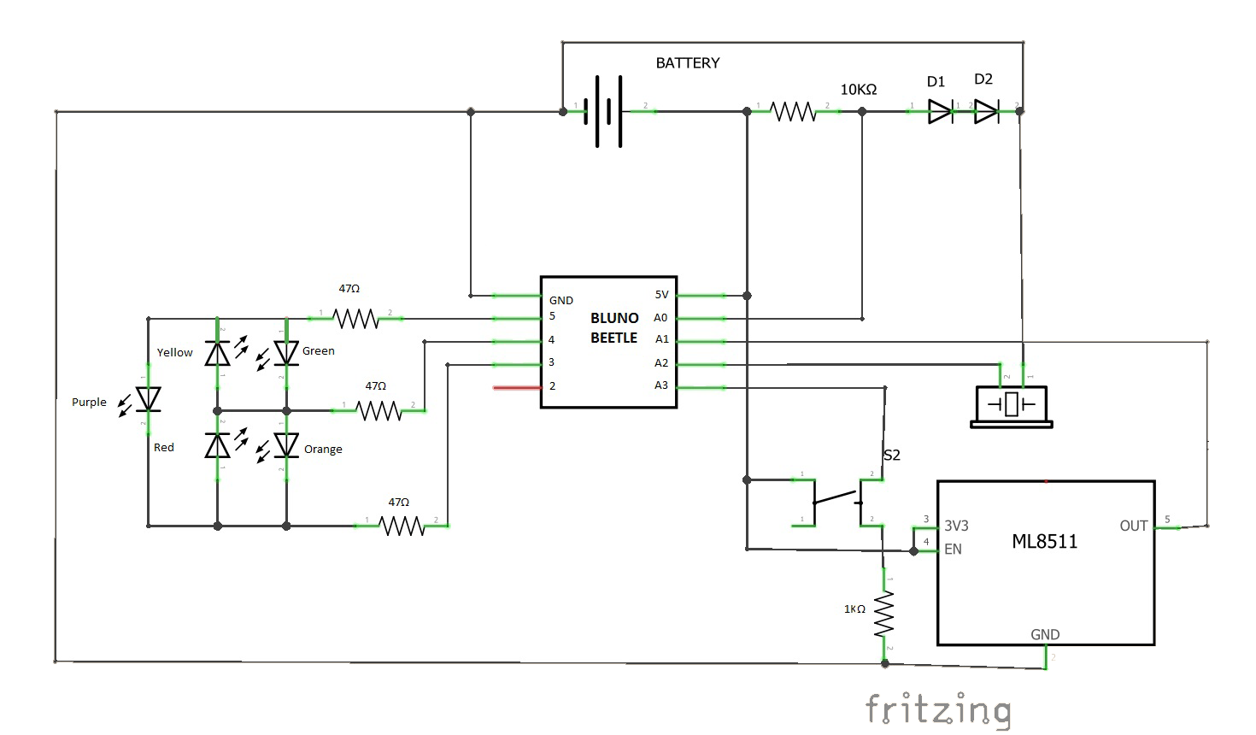
CONTROL SYSTEM

Slide 16

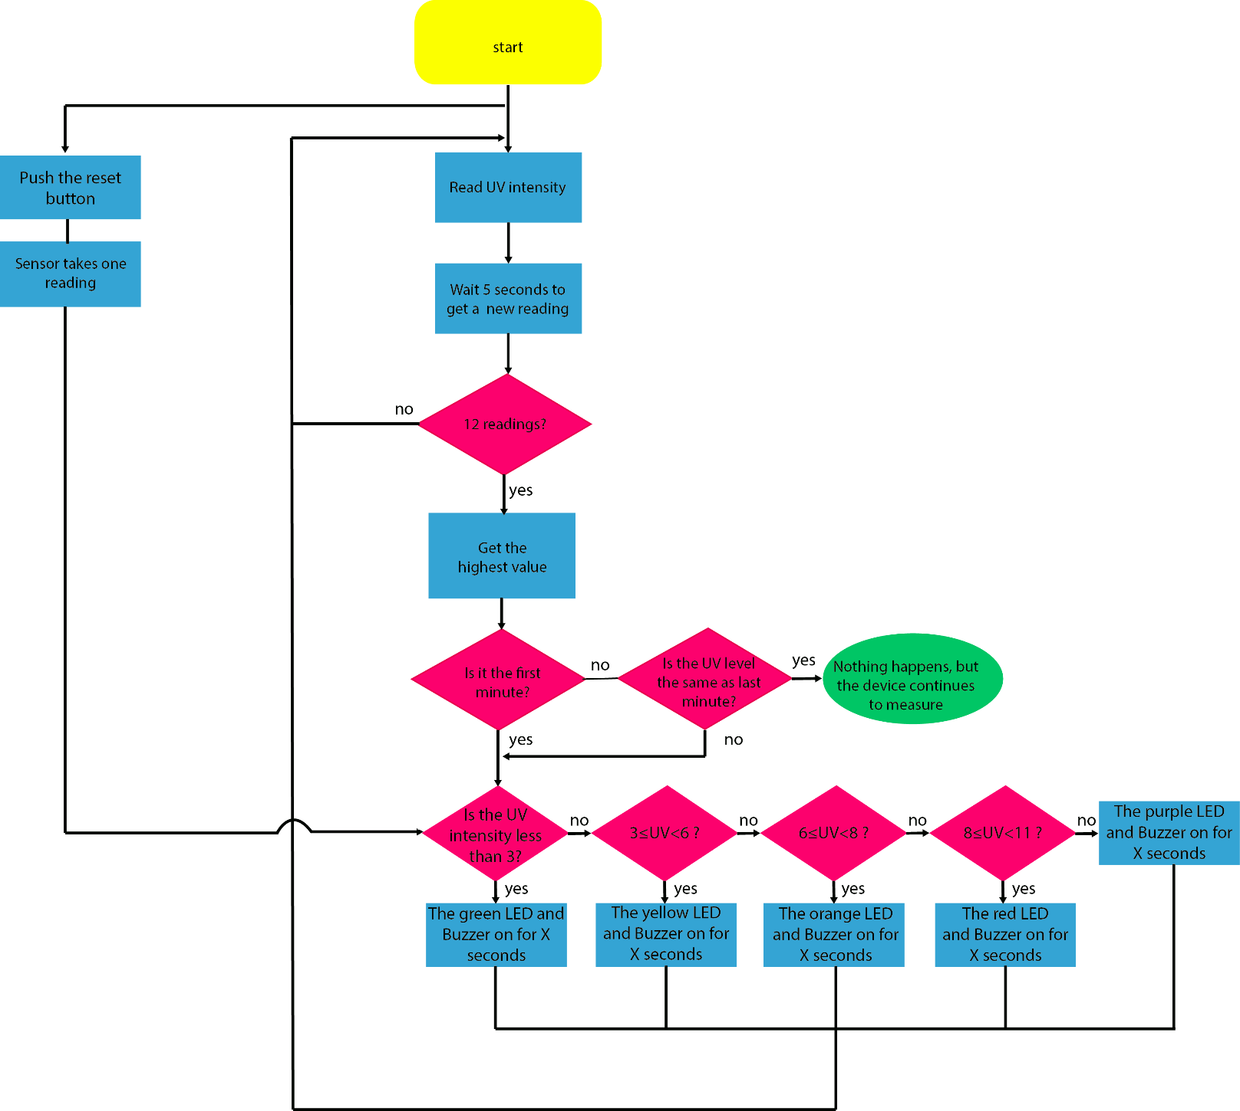
CONTROL SYSTEM

Slide 17

On/Off button
LED lights
Buzzer
Bluetooth
FUNCTIONALITIES

Slide 18

UV sensor test
Software test
Waterproof test
Wearability test
Robustness test
TESTS

Slide 19
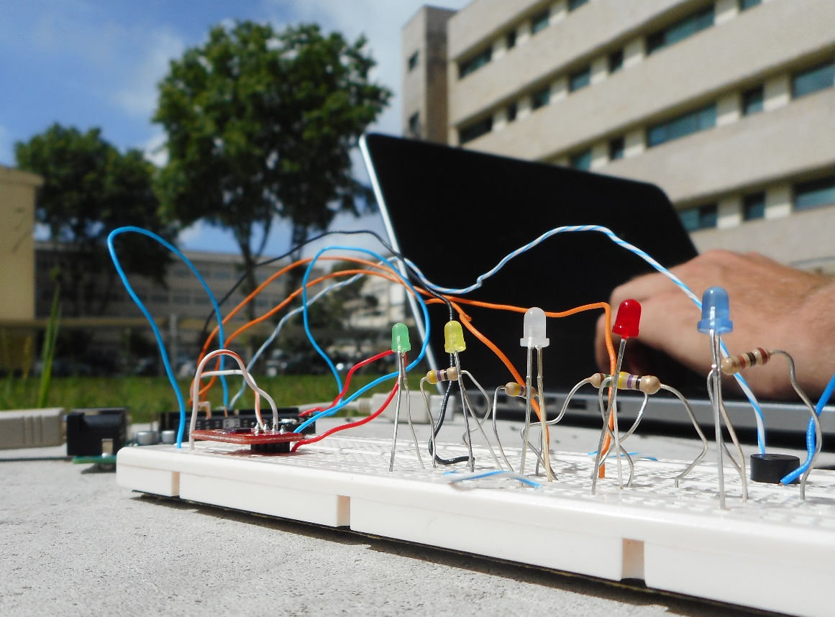
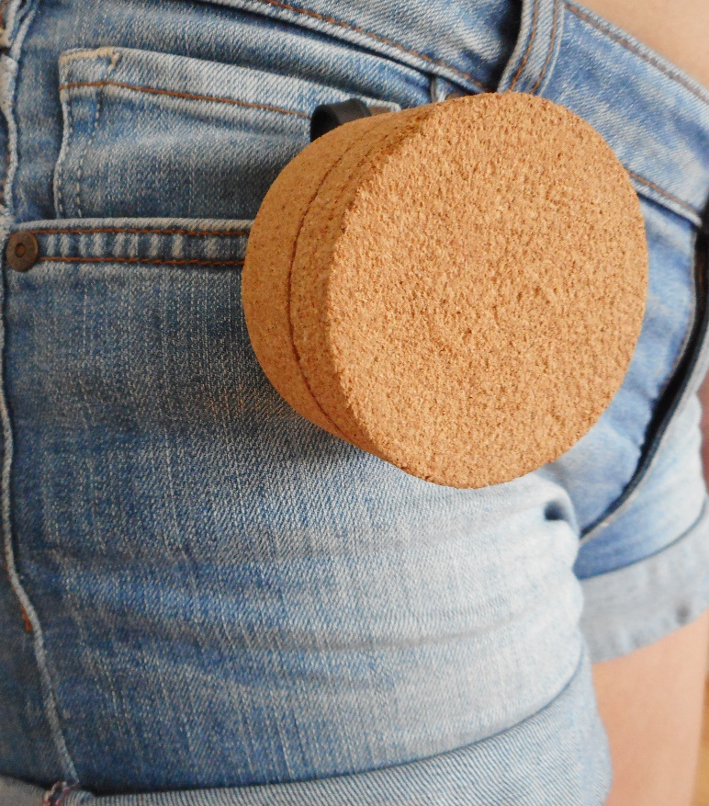
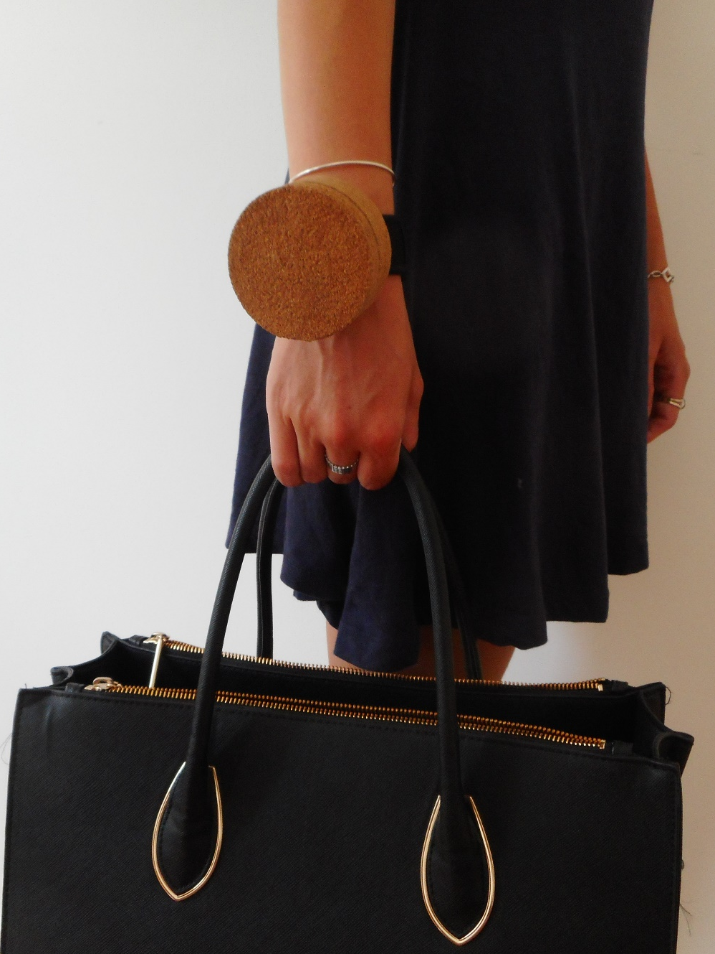
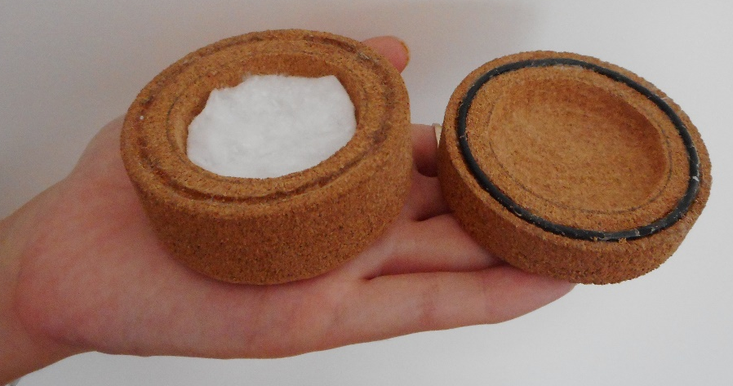
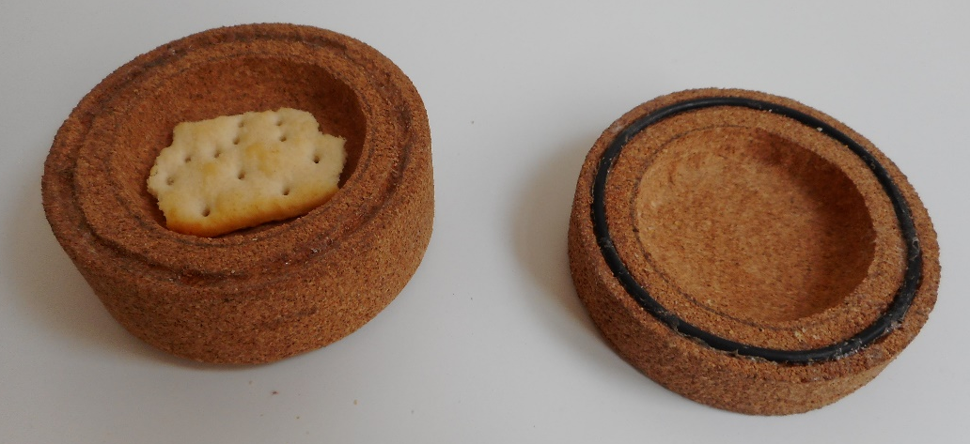
4
1&2
4
3
5
RESULTS

Slide 20



Final Prototype
CONCLUSIONS

Slide 21

Thank you!
Wearable UV meter
TEAM 2
https://miborber.wixsite.com/helios

